Slide 1


Basic Programming using C++
by Aqilah Rose

Slide 2
“Your best quote that reflects your approach… “It’s one small step for man, one giant leap for mankind.”
- Neil Armstrong

Slide 3
Outline
Introduction
Basic
C++ features
C++
Compiler
First Program
Hello world
Variables &
their types
Data
Types
Operators
in C++
Control Statement
Functions
Functions
in c++
Default
Arguments
C++
Recursion
If, if..else-if
Switch case in C++
Array
For Loop
While Loop
1D N 2D
Passing
Array to fc
C++ Strings
Do While Loop
Continue Statement
Pointers
Break Statement
goto statement
Pointers in C++
this pointer

Slide 4
Outline (Cont.)
Object Oriented Programming (OOP) Concept
OOP Concepts
Constructor
Destructor
Structure
How to Pass & return struct from function
Enumeration
Inheritance
Polymorphism
Function Overloading
Function Overriding
Virtual Function: Run time Polymorphism
Encapsulation
Abstraction
Interfaces-Abstract Class
Pass & Return Obj from Fc
Friend Class & Function

Slide 5
Array
1D & 2D Array
Passing
Array to fc
C++ Strings

Slide 6
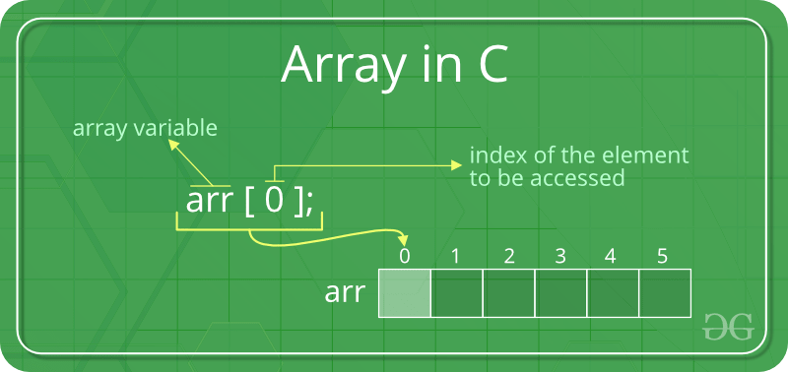

Slide 7
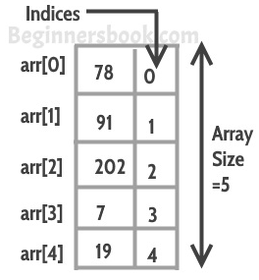
What is array?
An array is a collection of similar items stored in contiguous memory locations.
In programming, sometimes a simple variable is not enough to hold all the data. For example, lets say we want to store the marks of 500 students, having 500 different variables for this task is not feasible, we can define an array with size 500 that can hold the marks of all students.

Slide 8
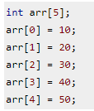


Declaring an array in C++
3 ways to declare

Slide 9
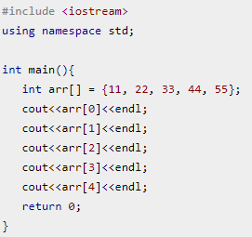
How to access the array?
Array index starts with 0, which means the first array element is at index 0, second is at index 1 and so on. We can use this information to display the array elements.
Although this code worked fine, displaying all the elements of array like this is not recommended. When you want to access a particular array element then this is fine but if you want to display all the elements then you should use a loop

Slide 10
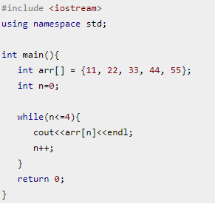
Use loop to iterate the data!

Slide 11
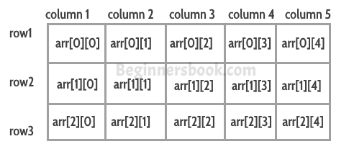
Multidimensional Arrays in C++
Multidimensional arrays are also known as array of arrays. The data in multidimensional array is stored in a tabular form as shown in the diagram below:

